Slide 1
Python Quick Camp
TDWI Accelerate - October 2017
Paul Boal - @paulboal

Slide 2
Purpose
Understand the latest trends in Python as a data science tool
Use Python to load, enrich, and analyze real-world data
Excel, csv, web services, HTML
Manage data using high-performance data structures
pandas, numpy
Visualize data and relationships using plots
matplotlib, pandas, seaborn, plotly
Organize complex code libraries using Python modules

Slide 3


About Me
Paul Boal @paulboal
Healthcare data and analytics solutions
Big data, IoT, and advanced analytics
Data strategy and data governance
Drive change through data insights
Husband and father of three
VP Delivery http://amitechsolutions.com @AmitechSolution

Slide 4
Agenda
What’s going on with Python?
Python Quick Camp
Python Jupyter 101
Real-world scenario
Getting data
Formatting data
Enriching data
Data profiling and analysis
Exercises
Q&A

Slide 5
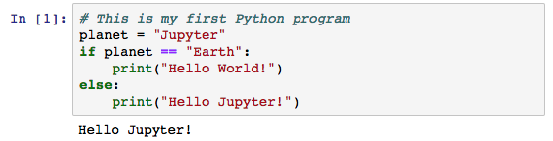
Hello Jupyter!
Introducing Jupyter
Comments are preceded by #.
Variables get assigned values with =.
Code blocks require consistent indenting.
Function calls use () to pass parameter values.
Jupyter organizes commands into cells that can hold code or documentation, and have results.
Jupyter is an interactive web-based programming notebook that shows commands and results in-line.
Jupyter launches separate Python interpreters for each running notebook.
Notebooks are independent and do not share variables or data back-and-forth.

Slide 6

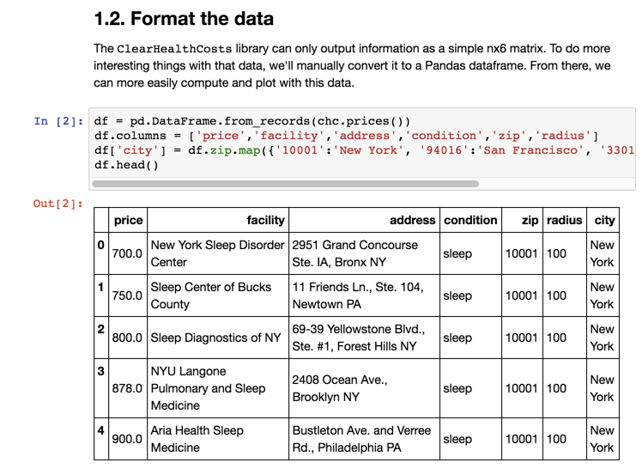
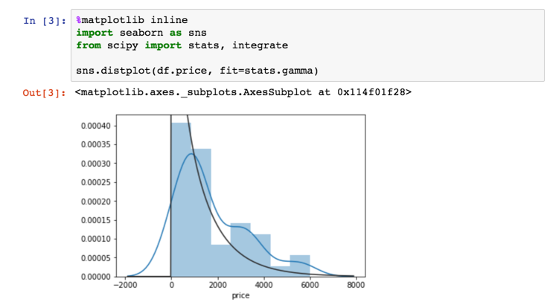
Introducing the Jupyter Notebook
Introducing Jupyter
Jupyter tool bars
Cell types
Documentation
Code
Output
Print statements
Variable contents
Plots
NOTE: Jupyter saves files with a .ipynb extension. These are structured JSON and contain all of the notebook contents including documentation, code, and visible results. The notebook file does not contain a snapshot of the variable contents – that only exists in the current Python instance.

Slide 7
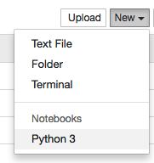
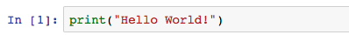
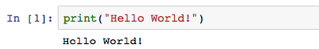
First Notebook
EXERCISE 1: Jupyter
Create a new Python Notebook in Jupyter
Write your hello world program
Run the current cell with Shift-Enter

Slide 8
Universities are Teaching Python
What’s going on with Python?
Fastest growing Q&A topic, especially in colleges and universities.
Growth driven almost entirely from pandas, numpy, matplotlib
https://stackoverflow.blog/2017/09/14/python-growing-quickly/

Slide 9
Universities are Teaching Python
What’s going on with Python?
Fastest growing Q&A topic, especially in colleges and universities.
Growth driven almost entirely from pandas, numpy, matplotlib
https://stackoverflow.blog/2017/09/14/python-growing-quickly/

Slide 10
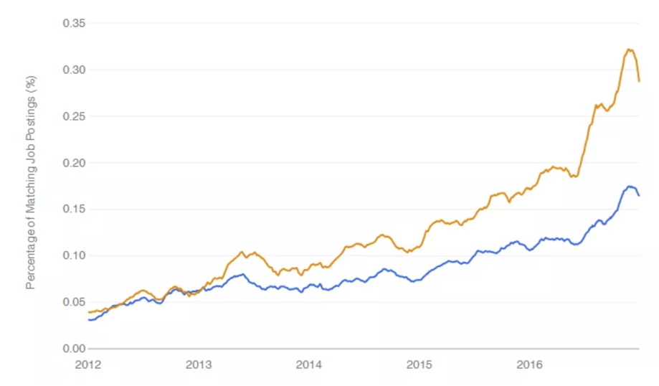
Python is on the rise
What’s going on with Python?
Growing faster than R as a requirement for data science related jobs.
Second only to SQL in technical skills required by a data scientist.
https://www.r-bloggers.com/data-science-job-report-2017-r-passes-sas-but-python-leaves-them-both-behind/

Slide 11
Why choose Python for Data Science?
What’s going on with Python?
A multi-purpose language
Easy to learn syntax
Interactive and reproducible plots
Large and growing data and analytics libraries
Integration with big data platforms (e.g. Spark)
Build complete applications in a single language
Multiple ways to interact with Python: command line, IDE, notebook
https://www.datacamp.com/community/tutorials/r-or-python-for-data-analysis#gs.JoPn0p4

Slide 12
Introduction
Business Scenario:
Healthcare costs vary dramatically from one facility to the next, even in the same community.
Are there any geographic features that might be tied to those cost patterns?
Steps:
Getting procedure costs
Get facility information
Get additional external data
Review correlations in data
Retrieve Git repository with code and data from https://github.com/paulboal/tdwi-accelerate-2017-python

Slide 13
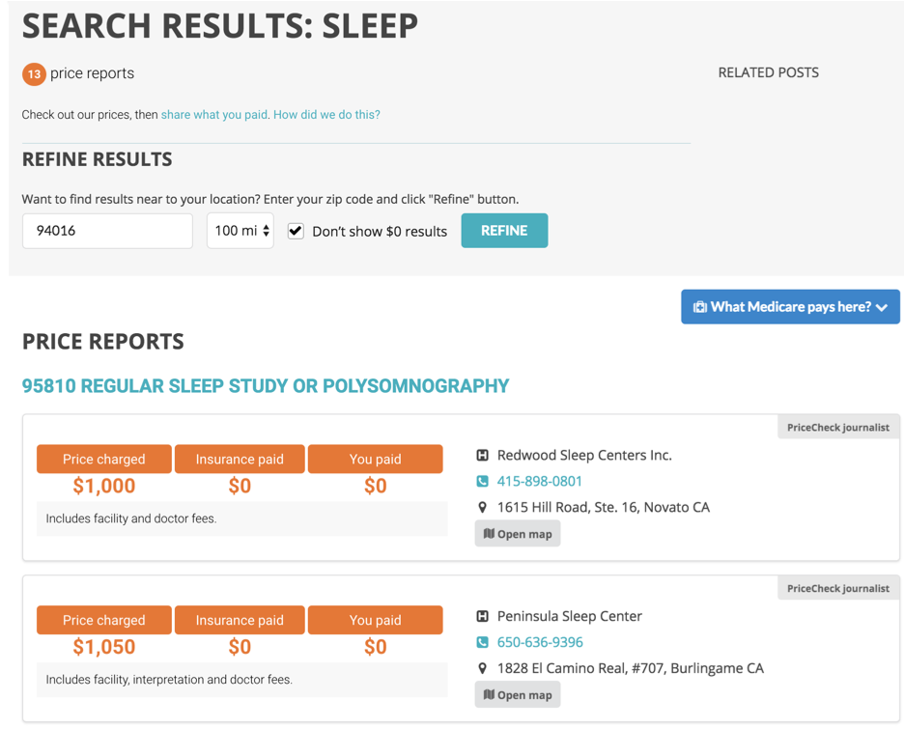
1. Get Procedure Costs
1. Get Procedure Costs
Clear Health Costs is a web site that let’s users search for procedure costs around particular ZIP codes in several large cities.
Our first step is to run searches against this web site and collect the data.
All in fewer than 70 lines of code!

Slide 14
Using Modules
1. Getting procedure costs
from GetPrices import ClearHealthCosts
import pandas as pd
chc = ClearHealthCosts()
chc.get_sleep_prices('10001',100) # New York
chc.get_sleep_prices('94016',100) # San Francisco
chc.get_sleep_prices('33018',100) # Miami
chc.get_sleep_prices('75001',100) # Dallas
In the notebook, all you see are some imports and calls to get_sleep_prices().
All of the code for how to retrieve data from Clear Health Costs is encapsulated in GetPrices.py.
The key to using this personal module is from GetPrices import GetHealthCosts.
This Jupyter cell also imports pandas, but it isn’t used until later.
TDWI_Python_QuickCamp_2017.ipynb

Slide 15
GetPrices Module: Parse HTML with BeautifulSoup
1.1 Get the data
from bs4 import BeautifulSoup
import requests
class ClearHealthCosts:
...
def get_prices(self, condition, zip, radius):
url = self._get_base_url(condition, zip, radius)
result = requests.get(url)
if result.status_code == 200:
prices = self._parse_pricelist(result.content)
for i in range(0,len(prices)):
prices[i] += [condition, zip, radius]
self._prices += prices
return self
...
More dependencies being imported within the GetPrices module:
BeautifulSoup – parsing HTML
requests – calling web services or pages
Using a class structure to encapsulate variables rather than relying on global variables.
Within a class definition, internal variables and functions are prefixed by self.
GetPrices.py

Slide 16
Getting Prices: Thinking in Objects
PYTHON BASICS: Object-Oriented
Procedural Programming:
Functions are managed and run at globally
Variables and data are either local to a function or global
Object-Oriented Programming
Code execution is still linear
Classes hide complex data structures and related functions in one variable
Step 1
Step 1.1()
Step 1.2()
Step 2
Step 2.1()
Step 2.2()
Step 2.3()
Step 1
Step 2
Variable A
Step 1.1()
Step 1.2()
Variable B
Step 2.1()
Step 2.2()
Step 2.3()
Variable A
Variable B
Variable C

Slide 17
Getting Prices: Steps
1.1 Get the data
Generate URL
Pull content from URL
Parse HTML
For each item in the price list
Return list of prices
Parse the price info

Slide 18
Getting Prices: get_sleep_prices()
1.1 Get the data
def get_sleep_prices(self, zip, radius=100):
return self.get_prices('sleep', zip, radius)
GetPrices.py
def defines a new function or method
All class methods include self as the first parameter
Parameters can have default values, making them optional
This function simply calls another class method
Key goal of object-oriented programming: testability, reusability, flexibility

Slide 19
Getting Prices: get_prices()
1.1 Get the data
def get_prices(self, condition, zip, radius):
url = self._get_base_url(condition, zip, radius)
result = requests.get(url)
if result.status_code == 200:
prices = self._parse_pricelist(result.content)
for i in range(0,len(prices)):
prices[i] += [condition, zip, radius]
self._prices += prices
return self
Call another function to create the URL by concatenating all the pieces together
Use the requests module to call that URL and get the HTML back.
If you get an OK result, then parse the price list and return a list that has the prices and the input parameters.
Strings can be concatenated just by “adding” them together.
def _get_base_url(self, query, zip_code, radius):
return self._base_url+'query='+str(query)+
'&zip_code='+str(zip_code)+
'&radius='+str(radius)+'&submit='
GetPrices.py

Slide 20
Loops and Lists
PYTHON BASICS: Loops and Lists
alpha = ['a', 'b', 'c', 'd', 'e']
A list is just a series of values. They don’t have to be the same data type.
To create a list, enclose the list of elements with brackets.
Get a slice of a list using indexes inside of brackets.
Loop through a list by using the range sequence generator.
Also note how the print and format functions work together with {} as placeholders.
alpha[0]
'a'
alpha[2:5]
['c', 'd', 'e']
for i in range(len(alpha)):
print("{} : {}".format(i,alpha[i]))
0 : a
1 : b
2 : c
3 : d
4 : e

Slide 21
Getting Prices: parse_pricelist()
1.1 Get the data
def _parse_pricelist(self, page):
prices = []
soup = BeautifulSoup(page, 'html.parser')
items = soup.findAll('div', 'ui grid segment')
for item in items:
price = self._parse_price(item)
prices.append(price)
return prices
Create an empty list for storing results.
BeautifulSoup’s findAll function returns a list of all HTML elements of a given type (div) with certain classes (ui grid segment).
We can also just loop over the elements in a list.
The append just adds the next set of information to the end of the prices list.
GetPrices.py

Slide 22
Working with Lists
EXERCISE 2: Lists
Create a list with your first, middle, and last name
Write a loop that prints each part of your name
Write a function that prints your name in Last, First Middle

Slide 23
Working with Lists
EXERCISE 2 - Solution
Create a list with your first, middle, and last name
Write a loop that prints each part of your name
Write a function that prints your name in Last, First Middle
name = ['Paul','Emre','Boal']
for part in name:
print(part)
def format_name(n):
print("{}, {} {}".format(n[2],n[0],n[1]))
format_name(name)

Slide 24
Processing Data: Introducing the DataFrame
1.2 Format the data
df = pd.DataFrame.from_records(chc.prices())
df.columns = ['price','facility','address','condition','zip','radius']
df.head()
TDWI_Python_QuickCamp_2017.ipynb
700.0 | New York Sleep Disorder Center | 2951 Grand Concourse Ste. IA, Bronx NY | sleep | 10001 | 100 | New York
750.0 | Sleep Center of Bucks County | 11 Friends Ln., Ste. 104, Newtown PA | sleep | 10001 | 100 | New York
800.0 | Sleep Diagnostics of NY | 69-39 Yellowstone Blvd., Ste. #1, Forest Hills NY | sleep | 10001 | 100 | New York
878.0 | NYU Langone Pulmonary and Sleep Medicine | 2408 Ocean Ave., Brooklyn NY | sleep | 10001 | 100 | New York
900.0 | Aria Health Sleep Medicine | Bustleton Ave. and Verree Rd., Philadelphia PA | sleep | 10001 | 100 | New York
Convert the list of values coming back from Clear Health Costs into a Pandas DataFrame
Add labels for the columns
Take a peak at the top 5 or 10 rows of data
chc.prices() returns a list of lists with no metadata

Slide 25
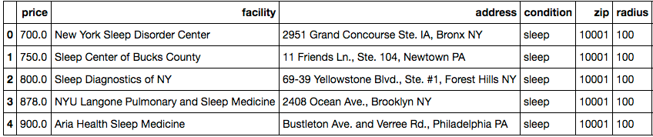
What is a DataFrame?
PYTHON BASICS: DataFrame
The'address' series
Values at the index of 1
Pandas DataFrames can be thought of as a spreadsheet or pivot table in which every column and every row have a label.
Column labels are referred to as the Series and are usually meaningful strings
Row labels are referred to as the Index and can be numeric or strings
Column and row labels can be lists, creating a hierarchical structure

Slide 26
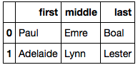
Creating and accessing a DataFrame
PYTHON BASICS: DataFrame
import pandas as pd
df = pd.DataFrame()
df['first'] = ['Paul', 'Adelaide']
df['middle'] = ['Emre', 'Lynn']
df['last'] = ['Boal','Lester']
df
Pandas implements Series and DataFrames to add lots of efficiency and functionality on top of basic lists and dictionaries.
Think of a DataFrame as a spreadsheet and a Series as one column.
Indexing a DataFrame using a column name returns all the values in that column allowing you to do convenient set operations.
DataFrames are compatible with NumPy arrays, so calculations can be run in parallel.
Indexing a DataFrame using the loc() function returns one row, but row-by-row access is usually less efficient.
df.loc[0]
First Paul
middle Emre
last Boal
Name: 0, dtype: object

Slide 27
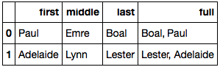
Set operations on a DataFrame
PYTHON BASICS: DataFrame
df['last'] + ', ' + df['first']
Doing set operations with DataFrames should feel natural to anyone who has worked with SQL before.
It might be awkward for developers coming from an application background.
If you come from an object-oriented application background, just look at this like operating on a collection of objects all at once.
0 Boal, Paul
1 Lester, Adelaide
df['full'] = df['last'] + ', ' + df['first']
df

Slide 28
Working with DataFrames
EXERCISE 3: DataFrame
Start with the 2-dimensional list below
Convert this to a DataFrame
Label the columns “street”, “city”, “state”
Add a new series called “label” that is formatted as you would expect
addresses = [
['1 CityPace Drive', 'Creve Coeur', 'MO'],
['350 Fifth Avenue', 'New York', 'NY'],
['221 B Baker St', 'London', 'England']
]

Slide 29
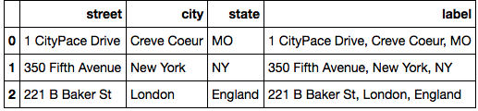
Working with DataFrames
EXERCISE 3 - Solution
addresses = [
['1 CityPace Drive', 'Creve Coeur', 'MO'],
['350 Fifth Avenue', 'New York', 'NY'],
['221 B Baker St', 'London', 'England']
]
df = pd.DataFrame(addresses)
df.columns = ['street','city','state']
df['label'] = df['street'] + ', ' + df['city'] + ', ' + df['state']
df

Slide 30
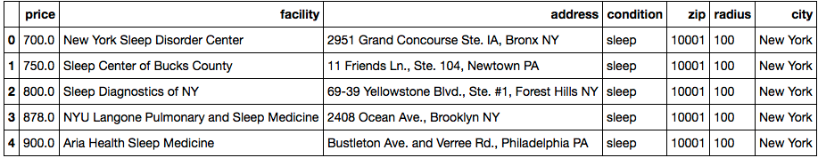
Making Data Readable: Code to Descriptions Maps
1.2 Format the data
df['city'] = df[’zip'].map({'10001':'New York',
'94016':'San Francisco',
'33018':'Miami',
'75001':'Dallas'})
df.head()
TDWI_Python_QuickCamp_2017.ipynb
Use a dictionary to represent the relationship between ZIP code and metropolitan area.
Map the existing ZIP code field into a city name and store that.

Slide 31
Dictionaries
PYTHON BASICS: Dictionaries
dictionary = {
name1 : value1,
name2 : value2...
}
A dictionary is a map between names and values, where the values can be any complex data type including another dictionary, a list, or a scalar value.
Dictionaries can be accessed by using the bracket similar similar to list indexing.
Dictionaries can easily be used for looking up information against a code or value list that maps to something definition.
me = {
'last' : 'Boal',
'middle': 'Emre',
'first' : 'Paul'
}
me['last']
'Boal'

Slide 32
Working with DataFrames
EXERCISE 4: DataFrame
Start with the 2-dimensional list below
Convert this to a DataFrame
Label the columns “street”, “city”, “state”
Add a new series called “label” that is formatted as you would expect
addresses = [
['1 CityPace Drive', 'Creve Coeur', 'MO'],
['350 Fifth Avenue', 'New York', 'NY'],
['221 B Baker St', 'London', 'England']
]

Slide 33
Working with DataFrames
EXERCISE 4 - Solution
addresses = [
['1 CityPace Drive', 'Creve Coeur', 'MO'],
['350 Fifth Avenue', 'New York', 'NY'],
['221 B Baker St', 'London', 'England']
]
df = pd.DataFrame(addresses)
df.columns = ['street','city','state']
df['label'] = df['street'] + ', ' + df['city'] + ', ' + df['state']
df

Slide 34
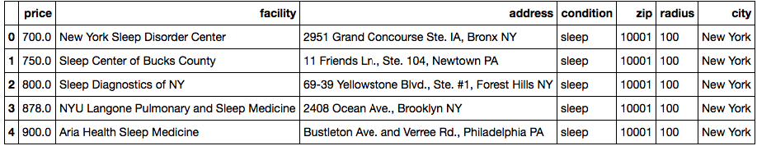
Price Distribution
1.3 Quick data profiling
What does the distribution of prices look like?
Descriptive statistics, histogram, distribution plot
How do prices vary with respect to the city they are from?
Distribution by city, correlation analysis

Slide 35
Histograms
1.3 Quick data profiling
%matplotlib inline
import seaborn as sns
from scipy import stats, integrate
sns.distplot(df.price, fit=stats.gamma)
Tell Jupyter that we want charts to appear inline in the notebook
Import the seaborn plotting library
Create a distribution plot including alternative distribution fits (e.g. gamma)
One observation we can make is that the distribution is weighted toward the low-end of prices, but there are bubbles at higher levels.
What causes those?
TDWI_Python_QuickCamp_2017.ipynb

Slide 36
Plotting Libraries
PYTHON BASICS: Plotting Libraries
Package | Uses
matplotlib | Basic plotting capabilities following the paradigms from Matlab designed for scientific publications. Not built with web based notebooks in mind first, but interactive charts are available.
pandas | DataFrames have built-in plotting functions that use matplotlib under the hood.
seaborn | This library makes the default matplotlib plots prettier and adds many functions to make common plotting activities easier.
plotly | Plot.ly is much more than just a plotting library. It’s a comprehensive web service that gives analysts a way to manage and share data, code, and visualizations. Basic and public usage is free, but enterprise services are paid.
bokeh | An Open Source plotting library that makes interactive web graphics easier to create within environments like Jupyter.

Slide 37
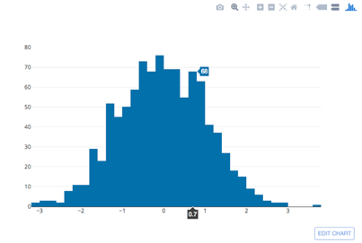
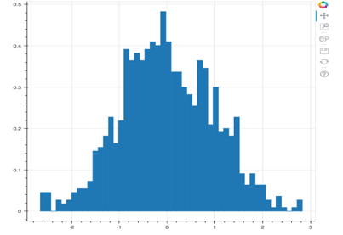
Feature Comparison
PYTHON BASICS: Comparing plotting libraries
 | matplotlib | pandas | seaborn | plotly | bokeh
Histogram Code | plt.hist(data) | df.hist() | sns.distplot( df, kde=False) | py.iplot( [go.Histogram(x=data)], filename='inline') | p = figure() hist, edges = np.histogram(data, density=True, bins=50) p.quad(top=hist,bottom=0) show(p)
Histogram Output
Easy simple plots
Easy statistical plots
Interactivity
Open source

Slide 38
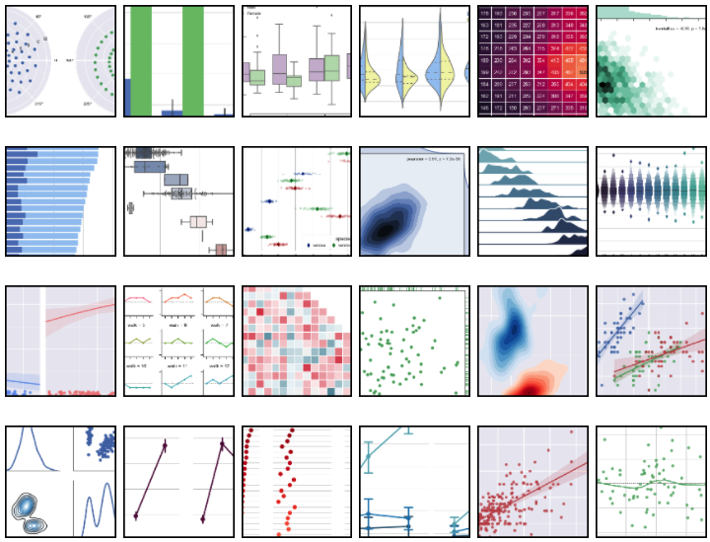
Seaborn Gallery
PYTHON BASICS: Plots with Seaborn
Distribution of Dataset
Categorical Data
Linear Relationships
Pairwise Relationships
http://seaborn.pydata.org/tutorial.html

Slide 39
Histogram Options
PYTHON BASICS: Seaborn Histogram Options
Parameter | Description
a | Data to plot: Series, 1d-array, or list
hist | True/False: Include the histogram in the output
kde | True/False: Include the gaussian kernel density estimate
rug | True/False: Include a rugplot on the support axis
color | Change the color, by name
axlabel | Label to put on the support axis
https://seaborn.pydata.org/generated/seaborn.distplot.html

Slide 40
Seaborn Histograms
EXERCISE 5: Histogram
Start with the dataset below
Use seaborn to plot a histogram
Change the color of the plot
Add and remove the histogram, kde, and rug
data = np.random.normal(size=1000)

Slide 41
Seaborn Histograms
EXERCISE 5 - Solution
%matplotlib inline
import seaborn as sns
import numpy as np
data = np.random.normal(size=1000)
sns.distplot(data)
%matplotlib inline
import seaborn as sns
import numpy as np
data = np.random.normal(size=1000)
sns.distplot(data,
color="Red",
hist=False)
%matplotlib inline
import seaborn as sns
import numpy as np
data = np.random.normal(size=1000)
sns.distplot(data,
color="DarkGreen",
hist=False,
rug=True,
axlabel=”variable")

Slide 42
Cleaning Bad Data: Filtering a DataFrame
1.4 Check for bad data
Not only are there a predominance of low values in this distribution, but there might be a lot of $0 results.
These don’t help and they skew the results.
Calculating how many there are and then filtering them out will be helpful.

Slide 43
Cleaning Bad Data: Filtering a DataFrame
1.4 Check for bad data
total = len(df)
zeros = sum(df.price == 0)
print("{} out of {} have a price of $0".
format(zeros, total))
Get the total number of entries
Count how many have a price of 0
Print out the results
12 out of 83 have a price of $0
df = df[df.price != 0]
len(df)
Filter the results by selecting only those that have a price not equal to 0.
71
TDWI_Python_QuickCamp_2017.ipynb

Slide 44
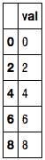
Testing Values and Filtering a DataFrame
PYTHON BASICS: Testing and Filtering DataFrames
import pandas as pd
df = pd.DataFrame()
df['val'] = range(10)
df['val'] % 2 == 0
import pandas as pd
df = pd.DataFrame()
df['val'] = range(10)
selector = df['val'] % 2 == 0
df[selector]
df['val'] % 2 == 0
Tests all the contents of the val series to see if their modulus 2 equals 0.
The result is a series of True / False values.
Note that True/False can be summed to get a count of how many are True.
df[selector]
The [selector] syntax selects the subset of values from the series where the selector value is True.
0 True
1 False
2 True
3 False
4 True
5 False
6 True
7 False
8 True
9 False

Slide 45
Filtering a DataFrame
EXERCISE 6: Filtering a DataFrame
Starting with the two lists below
Create a data frame with those series
Count how many people in the data frame are female
Display only the male people
people = ['Donna Wong','Edward Tufte','David Candless']
genders = ['female','male','male']

Slide 46
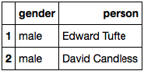
Filtering a DataFrame
EXERCISE 6 - Solution
import pandas as pd
people = ['Donna Wong','Edward Tufte','David Candless']
genders = ['female','male','male']
df = pd.DataFrame({'person': people, 'gender': genders})
sum(df['gender'] == 'female')
1
df[df['gender'] == 'male']

Slide 47
Drill Down: Histograms by Series
1.5 Break things down
sns.violinplot(data=df, y='price', x='city')
A violin plot makes a nice way to drill down into distribution by some categorical series.
Does the distribution of values vary based on the category value?
Seems clear that the price distribution in Dallas is different than New York.
TDWI_Python_QuickCamp_2017.ipynb

Slide 48
Break

Slide 49
Natural Language Processing in Python
2.1 Classifying the facilities
NLTK is the standard Python NLP toolkit
Tokenize – split documents into paragraphs, sentences, and words
Stemming – based on base words
Type of speech – based on vocabulary and usage context
Standard corpus – knowledge base for understanding language in context
Often used in conjunction with machine learning for:
Supervised document classification
Unsupervised document clustering
Sentiment analysis

Slide 50
Shortcut for iterating over lists
PYTHON BASICS: Inline loop shortcuts
This long unreadable line is really two nested for loops
Brackets mean that we’re going to be returning a list
4
ClassifyFacilities.py
tokens = [word for sent in nltk.sent_tokenize(text) for word in nltk.word_tokenize(sent)]
3
Just return the word, but we could do other operations hear, like calculate the length or change the case for example.
1
Tokenizing the input text as sentences returns a list of sentences that will be looped over…
2
For each of those sentences, use the word tokenizer to get all the individual words…

Slide 51
Inline for loop
EXERCISE 7: Filtering a DataFrame
Starting with the data below
Use the str.title() function and an inline for loop to create a new list that contains all of the names in proper / title case
names = ['paul','donna','edward','david']

Slide 52
Inline for loop
EXERCISE 7 - Solution
names = ['paul','donna','edward','david']
proper = [ n.title() for n in names ]
proper
['Paul', 'Donna', 'Edward', 'David']

Slide 53
Labeling Facility Types: Loops and Conditions
2.2 Label the clusters
By inspection, we can see a sort of general pattern to the name clusters that NLTK was able to identify.
Two tend to be “hospital” or “university” related
Only one mentions “physician” group
--------------------------------------------------------------------------------
0:medic,medic center,medicin,health,clinic,physician,center,intern,pulmonari,sleepm
--------------------------------------------------------------------------------
NYU Langone Pulmonary and Sleep Medicine,Aria Health Sleep Medicine,Sleep Medicine Associates of NYC,Lankenau Medical Center,Center for Sleep Medicine, Weill Cornell Medical College,Virtua Voorhees,Sutter Pacific Medical Foundation Sleep Center,Bay Sleep Clinic,Santa Clara Valley Medical,SleepMed,Woodland Healthcare,Sleep Medicine Services,Sleep Disorders Center at UCSF Medical Center at Mount Zion,Sleep Disorders Clinic Doctors Medical Center,Virtual Imaging Miami, Hialeah Sleep Lab,Pulmonary Physicians of South Florida, LLC,Choice Physicians of South Florida,International Institute of Sleep,Broward Health Medical Center,Delray Medical Center,United Health Systems,University of Miami Health System at Kendall,…
--------------------------------------------------------------------------------
1:center,disord,hospit,disord center,univers,hospit disord,hospit disord center,merci,holi cross,cross
--------------------------------------------------------------------------------
New York Sleep Disorder Center,Sleep Center of Bucks County,New York Cardiovascular Associates Sleep Wake Center,LCD Sleep Management Center,Lower Bucks Hospital,Center for Sleep Medicine at Mercy Hospital,Mercy Suburban Hospital Sleep Disorders Center,Fairfield County Sleep Center,Sleep Disorders Institute,The Bronx Pulmonary Center for Pulmonary, Asthma and Sleep Disorders,Mercy Fitzgerald Hospital Sleep Disorders Center,The Sleep Center at Greenwich Hospital,Bryn Mawr Hospital,Paoli Hospital for Sleep Medicine,Sleep Center at Riddle Hospital,John T. Mather Hospital Sleep Disorders Center,Danbury Hospital Sleep Disorders Center,Sleep Disorders Center,New York Sleep, Sinus & Thyroid Surgery Center,Redwood Sleep Centers Inc.,Peninsula Sleep Center,California Center for Sleep Disorders,North Coast Sleep Center - Santa Rosa,The Sunnyvale Sleep Center,Sleep-Wake Disorders Center of Miami,…
--------------------------------------------------------------------------------
2:diagnost,medic diagnost,unit diagnost,unit,medic,eo,eo diagnost,diagnost hollywood,unit diagnost hollywood,hollywood
--------------------------------------------------------------------------------
Sleep Diagnostics of NY,EOS Sleep Diagnostics,Florida Sleep & Neuro Diagnostic Services Inc.,United Sleep Diagnostics Pembroke Pines,United Sleep Diagnostics Hollywood,Sunrise Medical Group Sleep Diagnostics,Texas Medical Diagnostics Inc.

Slide 54
Labeling Facility Types: Loops and Conditions
2.2 Label the clusters
cluster_names = classifier.get_cluster_names()
cluster_labels = {}
for num in cluster_names:
if 'physician' in cluster_names[num]:
cluster_labels[num] = 'clinic'
else:
cluster_labels[num] = 'hospital'
print(cluster_labels)
df['cluster'] = classifier.get_clusters()
df['facility_type'] = df.cluster.map(cluster_labels)
Our simplistic business rule will be that any cluster in which “physician” was a key word will be labeled as a “clinic” facility.
All others will be labeled as “hospital” facilities.
{0: 'clinic', 1: 'hospital', 2: 'hospital'}
TDWI_Python_QuickCamp_2017.ipynb

Slide 55
Looping and testing for values
EXERCISE 8: Loops and conditions
Starting with the data below
Classify each name to see if it is male, female, or unknown
Return a dictionary of
names = ['paul','donna','edward','jean']
male = ['paul','donna','edward']
female = ['donna','julia','alice']

Slide 56
Looping and testing for values
EXERCISE 7 - Solution
names = ['paul','donna','edward','jean']
male = ['paul','edward']
female = ['donna','julia','alice']
genders = {}
for n in names:
if n in male:
genders[n] = 'male'
elif n in female:
genders[n] = 'female'
else:
genders[n] = 'unknown'
genders
{'donna': 'female', 'edward': 'male', 'jean': 'unknown', 'paul': 'male'}

Slide 57
2. Getting more information about these facilities
2. Get Facility Information
Fairfield County Sleep Center
Sleep Disorders Institute
Mercy Fitzgerald Hospital Sleep Disorders Center
Sleep Medicine Associates of NYC
The Sleep Center at Greenwich Hospital
Lankenau Medical Center
Bryn Mawr Hospital
Paoli Hospital for Sleep Medicine
Sometimes you can infer information about something from other information you already have. For example, these facility names may hint at if they are a free-standing clinic, hospital-based, university-affiliated, or physician groups.
We may be able to use natural language processing (NLP) to cluster the facility names so that we don’t have to manually categorize each name.

Slide 58
Clean Addresses: Google Maps Geocoding
3.1 Geocode addresses
def get_zip(self):
try:
if self._results:
for component in self._results['results'][0]['address_components']:
if 'postal_code' in component['types']:
return component['long_name']
else:
return ''
except:
return ''
GeoCode.py
If there are any results
Loop through the components of the first result’s address_components
If the type is postal_code, then return the value (long_name)

Slide 59
Looking at Facility Types: Histograms and Bars
2.3 Compare the distributions by label
sns.violinplot(data=df, y='price', x='facility_type')
sns.countplot(data=df, x='facility_type')
TDWI_Python_QuickCamp_2017.ipynb
Look at distribution by facility type
Look at the split between how many were classified as hospital or clinic
Note that NLP clustering is non-deterministic (results can vary from one run to the next)

Slide 60
3. Get Additional External Data
3. Bring in external data
24 Hospital Ave., Danbury CT
100 Bowman Drive, Voorhees, NJ 08060, United States
210 Williamson St., Elizabeth NJ
310 E. 14th St., #6, New York NY
1615 Hill Road, Ste. 16, Novato CA
1828 El Camino Real, #707, Burlingame CA
985 Atlantic Avenue, Ste. 250, Alameda CA
95 Montgomery Drive, Ste. 104, Santa Rosa CA
1375 Sutter Street, #216, San Francisco CA
3867 Montgomery Drive, Santa Rosa CA
751 S. Bascom Ave., 7th Fl., #7C054, San Jose CA
Perhaps the costs depend on the kind of neighborhood where the facility is located.
Census data is one convenient (if not very sophisticated) way to get those demographics.
However, the addresses are not consistently formatted and rarely have the facility ZIP code.

Slide 61
JSON Documents
PYTHON BASICS: JSON
{
"results" : [
{
"address_components" : [
{ "long_name" : "310",
"types" : [ "street_number" ] },
{ "long_name" : "East 14th Street",
"types" : [ "route" ] },
{ "long_name" : "Manhattan",
"types" : [ "political", "sublocality", "sublocality_level_1" ] },
{ "long_name" : "New York",
"types" : [ "locality", "political" ] },
{ "long_name" : "New York County",
"types" : [ "administrative_area_level_2", "political" ] },
{ "long_name" : "New York",
"types" : [ "administrative_area_level_1", "political" ] },
{ "long_name" : "United States",
"types" : [ "country", "political" ] },
{ "long_name" : "10003",
"types" : [ "postal_code" ] }
],
"formatted_address" : "310 E 14th St, New York, NY 10003, USA",
"geometry" : {
"location" : {
"lat" : 40.7318919, "lng" : -73.9845859
},
"location_type" : "ROOFTOP",
},
"place_id" : "ChIJoTxfQJ5ZwokRkHhWBp-_83I",
"types" : [ "street_address" ]
}
],
"status" : "OK"
}
JavaScript Object Notation (JSON) is a way to describe arbitrarily complex collections of lists, dictionaries, and values.
List: [v1, v2, v3]
Dictionary: [ n1: v1, n2: v2]

Slide 62
Checkpoint Your Data: Saving and Loading Excel
3.1 Geocode addresses
Pandas has built-in integration with Excel read/write libraries.
This makes it easy to checkpoint your data to disk in a readable format.
df.to_excel('./facilities_checkpoint.xlsx')
import pandas as pd
df = pd.read_excel(
'./facilities_checkpoint.xlsx',
converters={'facility_zip':str})
TDWI_Python_QuickCamp_2017.ipynb
Note that when reading the DataFrame back in from Excel, Pandas (like Excel) will want to interpret the numeric values in the ZIP column as numbers. This will lose the formatting of leading zeros, so we tell Pandas to keep the ZIP code column as a string.

Slide 63
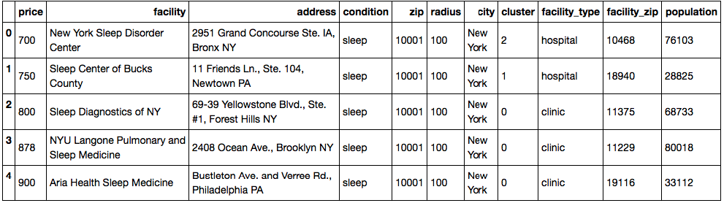
Get Local Population: DataFrames as Lookups
3.2 Census data
from CensusLookup import CensusLookup
lkp = CensusLookup()
population = df['facility_zip'].apply(lambda x:
lkp.get_value(x,
'Number; SEX AND AGE - Total population'))
df['population'] = population.apply(lambda x:
int(str(x)) if str(x).isdigit() else 0)
CensusLookup encapsulates the work of reading in the census file and converting it to a data frame.
We use the DataFrame apply() method and an inline lambda function to first lookup the population and then convert that population to an integer value.
TDWI_Python_QuickCamp_2017.ipynb

Slide 64
Lambda syntax
PYTHON BASICS: Inline functions
df = pd.DataFrame({ 'birth_dt': ['1974-05-23', '1977-09-25', '2003-01-11']})
def get_month(d):
return d[5:7]
df['birth_dt'].apply(get_month)
df['birth_dt'].apply(lambda d: d[5:7])
Create a named function and apply it to the DataFrame series
Clearer code but takes up more space
Use an anonymous, inline lambda function to avoid creating a named function.
Brief, but less reusable

Slide 65
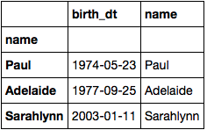
DataFrame index values
PYTHON BASICS: Setting DataFrame index values
Each row in a DataFrame is accessible via a label or row index.
If you know the row index, looking up the contents of that row can be very fast.
This kind of structure is often used for lookups, just like a dictionary.
df = pd.DataFrame({
'name': ['Paul', 'Adelaide', 'Sarahlynn'],
'birth_dt': ['1974-05-23', '1977-09-25', '2003-01-11']
})
df = df.set_index(df['name'])
df
df.loc['Paul']['birth_dt']
'1974-05-23'

Slide 66
Plotting Relationships: Scatterplot / LM Plot
3.2 Census data
sns.lmplot(data=df, x='population', y='price', hue='facility_type')
TDWI_Python_QuickCamp_2017.ipynb
A good way to get a hint at the relationship between two variables is to use a scatter plot.
Seaborn has a function for quickly plotting linear regression models along with the scatter plot.
Many Seaborn plots also permit you use the hue parameter to plot separate categorical series using separate colors.
In this case population and price don’t appear to be closely correlated.

Slide 67
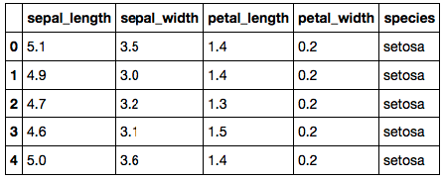
Seaborn scatterplots
EXERCISE 9: Visualizing correlation
Import the ubiquitous iris data set from seaborn
Create a scatter plot of petal_length verus petal_width
Color the plot in separate series based on species
import pandas as pd
df = sns.load_dataset("iris")

Slide 68
Seaborn scatterplots
EXERCISE 9 - Solution
sns.lmplot(data=df,
x='petal_width',
y='petal_length')
sns.lmplot(data=df, hue='species',
x='petal_width',
y='petal_length')

Slide 69
Plotting Relationships: Scatterplot / LM Plot
3.2 Census data
We followed the same pattern to plot other attributes versus price:
The percent of people who are middle-aged (45 – 64)
The percent of people are over 65
Nothing here looks particularly interesting except maybe the cut-offs.

Slide 70
4. Review Correlations in Data
4. Look at correlations
We want to look at several more potential relationships between price and the local ZIP code for each facility:
Percent; SEX AND AGE - Male population
Percent; RACE - Total population - One Race – White
Percent; RACE - Total population - One Race - Black or African American
Percent; RELATIONSHIP - Total population - In households – Nonrelatives
Percent; HOUSING OCCUPANCY - Total housing units - Vacant housing units
This work of doing lookups based on ZIP code, formatting the data properly, and examining possible correlations is repetitive.

Slide 71
Be a Lazy Programmer: Lists, Loops, and Lambda
4.1 Pull in several variables from census
factors = {
'pct_male': 'Percent; SEX AND AGE - Male population',
'pct_white': 'Percent; RACE - Total population - One Race - White',
'pct_black': 'Percent; RACE - Total population - One Race - Black or African American',
'pct_non_rel':'Percent; RELATIONSHIP - Total population - In households - Nonrelatives',
'pct_vacant': 'Percent; HOUSING OCCUPANCY - Total housing units - Vacant housing units',
}
def get_factor(d, lkp, factor):
values = d['facility_zip'].apply(
lambda x: [lkp.get_value(x,factor)]
)
return values.apply(
lambda x: sum(float(n) if re.match('^\d+?\.\d+?$',n)
else 0 for n in x)
)
for i, f in factors.items():
df[i] = get_factor(df, lkp, f)
Dictionary that maps series name to field name
Function to encapsulate the lookup process
Loop through the dictionary and get the data for each series
TDWI_Python_QuickCamp_2017.ipynb

Slide 72
Be a Lazy Programmer: Lists, Loops, and Lambda
4.1 Pull in several variables from census
Given existing input DataFrame (d), a CensusLookup (lkp), and name of a column:
Get the data from the lookup for each facility_zip in the input data.
Return that value as a float or 0 if the value is non-numeric.
This first lambda function calls get_value() from CensusLookup to get the value of the specified factor.
The second lambda function uses a regular expression (re) to test if the value looks like a number and then converts it to a float.
def get_factor(d, lkp, factor):
values = d['facility_zip'].apply(
lambda x: [lkp.get_value(x,factor)]
)
return values.apply(
lambda x: sum(float(n) if re.match('^\d+?\.\d+?$',n)
else 0 for n in x)
)
TDWI_Python_QuickCamp_2017.ipynb

Slide 73
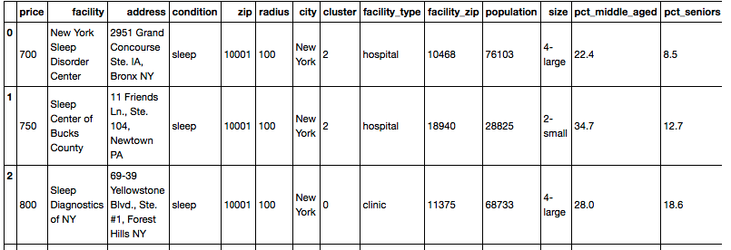
Be a Lazy Programmer: Lists, Loops, and Lambda
4.1 Pull in several variables from census
Then we loop through all of the series that we specified in the factor dictionary
Create a new column in our DataFrame for each result
for i, f in factors.items():
df[i] = get_factor(df, lkp, f)
df.head()
TDWI_Python_QuickCamp_2017.ipynb

Slide 74
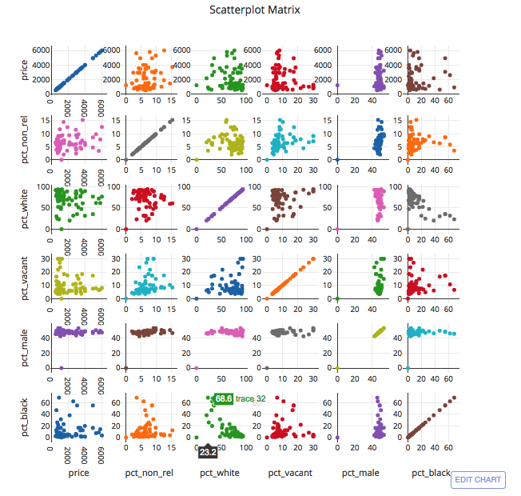
Scatterplot Matrix
4.2 Correlation plot with Plotly
import pandas as pd
import numpy as np
import scipy as sp
import plotly.plotly as py
import plotly.figure_factory as ff
corr_data = df[['price']+list(factors.keys())]
fig = ff.create_scatterplotmatrix(corr_data, height=800, width=800)
py.iplot(fig, filename='Basic Scatterplot Matrix')
TDWI_Python_QuickCamp_2017.ipynb
Retrieve only those columns we want to include in the correlation plot matrix.
Use plotly’s create_scatterplotmatrix()

Slide 75
Getting vertical slices of a Data Frame
PYTHON BASICS: Selecting columns from DataFrame
factors = {
'pct_male': 'Percent; SEX AND AGE - Male population',
'pct_white': 'Percent; RACE - Total population - One Race - White',
'pct_black': 'Percent; RACE - Total population - One Race - Black or African American',
'pct_non_rel':'Percent; RELATIONSHIP - Total population - In households - Nonrelatives',
'pct_vacant': 'Percent; HOUSING OCCUPANCY - Total housing units - Vacant housing units',
}
df[['price']+list(factors.keys())]
# df[['price','pct_male','pct_white','pct_black','pct_non_rel','pct_vacant']]
The list(factors.keys()) returns a list with the key names from factors.
Providing that list plus 'price' gives the complete list of desired columns.
Selecting that list of columns from the DataFrame returns a new DataFrame with only those selected columns.

Slide 76
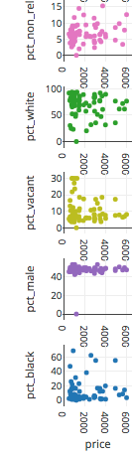
Scatterplot Matrix
4.2 Correlation plot with Plotly
Appears to be no relationship between price and the percent of homes where non-relatives are living.
Doesn’t appear to be a relationship between prices and percent of population of is white.
It may be that those facilities where the percent of vacant homes is highest, only low-price options are available.
The percent of male residents is narrowly around 50%
The highest end prices appear to only be in areas where the percent of black residents is under 20%

Slide 77
Plotly Gallery
Heatmaps
Confidence intervals
3-D plots
Network graphs
Sankey diagrams
Add lines and shaded areas

Slide 78
Review of Topics
Variables
Loops
Flow control
Functions
Modules
Web requests
Inline functions (lambda)
Inline for loops
Inline if statement
Lists
Dictionaries
Pandas Series
Pandas DataFrames
Plotting with seaborn and plotly
Parsing HTML
Reading / Writing Excel

Slide 79
What Next?
6. Further Analysis Ideas
Learn to manage your projects with Git: https://guides.github.com/activities/hello-world/
Turn your notebook into a slide show using nbconvert: http://www.damian.oquanta.info/posts/make-your-slides-with-ipython.html
Expand into big data processing with Spark: https://blog.sicara.com/get-started-pyspark-jupyter-guide-tutorial-ae2fe84f594f
Find a new and interesting problem! https://www.dataquest.io/blog/free-datasets-for-projects/ https://www.kaggle.com/

Slide 80
Q & A

